Slide 1
Students’ Addiction on Social Media
A Data Analytics Project Using Python
Presented by : Banumathy K

Slide 2
INTRODUCTION
The rise of social media has significantly transformed how students interact, learn, and spend their time.
This project analyzes students' social media usage to understand its impact on academic performance, mental health, and sleep patterns.
By exploring data from various countries and academic levels, it highlights key trends and potential signs of addiction.

Slide 3
INTRODUCTION ABOUT THE DATASET
Population: Students aged 16–25 enrolled in high school, undergraduate, or graduate programs.
Geography: Multi‐country coverage (e.g., Bangladesh, India, USA, UK, Canada, Australia, Germany, Brazil, Japan, South Korea).
Timeframe: Data collected via a one‐time online survey administered in Q1 2025.
Volume: Configurable sample sizes (e.g., 100, 500, 1,000 records) based on research needs.

Slide 4
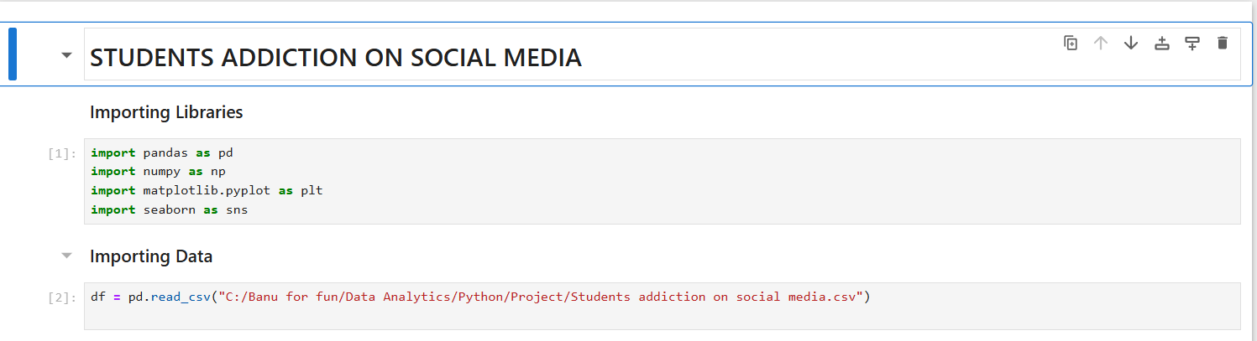
Data Preparation Summary
🛠 Imported Libraries
pandas for data manipulation
numpy for numerical operations
matplotlib and seaborn for data visualization
📥 Loaded Dataset
File: Students addiction on social media.csv

Slide 5
Initial Data Exploration and Structure Overview
🔍 Sample Data: Viewed 10 random records to get a quick look at the dataset.
SYNTAX = df.sample(10)
📊 Dataset Size: Contains 705 rows and 13 columns.
SYNTAX = print("No of Rows & Columns :", df.shape)
🔠 Data Types: Identified column data types (e.g., int, float, object).
SYNTAX = df.dtypes
❌ Missing Values: Checked and found no missing data.
SYNTAX = df.isnull().sum()
📈 Descriptive Statistics: Reviewed key statistics like mean, min, max, and standard deviation for numerical columns.
SYNTAX = df.describe()

Slide 6
DATA CLEANING
Data Cleaning is the process of identifying and correcting errors, inconsistencies, or inaccuracies in a dataset to ensure the data is accurate, complete, and ready for analysis. It involves handling duplicates, missing values, formatting issues, and standardizing values.
Cleaned and standardized the dataset by correcting country names, mapping them to country codes, and exploring key categorical variables. Removed inconsistencies, verified uniqueness, and reordered columns for improved data structure and readability.

Slide 7
🔍 Insights from the Data Cleaning Code
Code | Insight
df.nunique() | Helped identify which columns are categorical and how diverse their values are.
df.duplicated().any() | Confirmed that the dataset has no duplicate entries, ensuring reliability.
df['Country'].replace({...}) | Standardized country names (e.g., "USA" → "United States of America") for consistency in analysis.
print(df[col].unique()) | Revealed the range of responses in columns like platform usage and academic level, helping spot typos or uncommon values.
df['CountryCode'] = df['Country'].map(CountryCode) | Added a new column with country codes to simplify geographic analysis and plotting.
df.pop('CountryCode') + df.insert(...) | Rearranged the columns for better readability and logical structure of the dataset.

Slide 8
📌 KEY PERFORMANCE INDICATOR
⭐ Why is KPI Important?
Focuses on Critical Metrics Helps highlight the most important factors affecting the outcome.
Tracks Progress Monitors improvement or decline over time.
Supports Decision-Making Provides a clear basis for adjusting strategies or taking action.
Increases Transparency Makes performance visible to stakeholders and teams.
A Key Performance Indicator (KPI) is a measurable value that shows how effectively a project, process, or individual is achieving specific objectives. In data analytics, KPIs help track important metrics to evaluate performance and make data-driven decisions.

Slide 9
🧭 KPI Dashboard – Summary
This code creates a visual dashboard using Plotly to display key metrics about student social media usage.
Code | Function / Purpose
df['Country'].nunique() | Counts the number of unique countries in the dataset
df['Most_Used_Platform'].nunique() | Counts the different social media platforms used
(df['Gender'] == 'Male').sum() | Calculates the total number of male students
(df['Gender'] == 'Female').sum() | Calculates the total number of female students
df['Avg_Daily_Usage_Hours'].mean() | Computes the average daily usage hours
round(..., 2) | Rounds the average to 2 decimal places
go.Indicator() | Creates individual KPI display elements
fig.add_trace() | Adds each KPI to the dashboard
fig.update_layout() | Defines the layout, style, and structure of the dashboard
fig.show() | Displays the final KPI dashboard

Slide 10
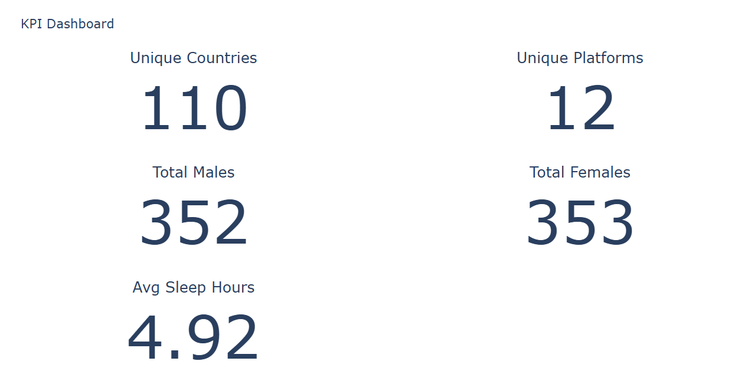
🔢 KPIs Displayed
KPI | Description
Unique Countries | Number of countries represented in the data
Unique Platforms | Different social media platforms used
Total Males | Count of male students
Total Females | Count of female students
Avg Sleep Hours | Average daily social media usage time

Slide 11
🧠 Insights Derived from KPI Analysis
Global Participation
With students from over 100 countries, the dataset reflects a broad, international view of social media habits among students.
Diverse Platform Usage
The presence of 12 different platforms shows that social media addiction isn't limited to one app
it's a cross-platform issue, with platforms like Instagram, TikTok, and WhatsApp leading.
Gender Balance
A fairly even number of male and female students allows for unbiased
gender-based comparisons in mental health, sleep, and addiction scores.
High Social Media Usage
An average of 4.9 hours per day spent on social media suggests that it’s a major part of students’ daily lives
potentially affecting productivity, health, and studies.
Reduced Sleep Hours
With an average of 6.9 hours of sleep per night, many students fall below recommended sleep levels,
hinting that excessive screen time might be a contributing factor.

Slide 12
Exploratory Data Analysis (EDA)
Exploratory Data Analysis (EDA) is the process of visually and statistically examining a dataset to discover patterns, detect anomalies, test assumptions, and check relationships between variables before applying machine learning or statistical models.
Charts used in this project :
Bar Chart – Platforms vs Academic Performance
Shows the number of students per platform categorized by whether their academic performance is affected.
Stacked Bar Chart – Mental Health & Sleep by Gender
Compares average mental health scores and sleep hours across male and female students.
Pie Chart – Countries by Academic Level
Visualizes the percentage of countries that have students at each academic level (Undergraduate, Graduate, High School).

Slide 13
Platforms Affecting Academic Performance
This bar chart compares how different social media platforms are associated with students' self-reported academic performance.
A cross-tabulation was created between Most_Used_Platform and Affects_Academic_Performance to count the number of students reporting "Yes" or "No" for each platform.
The plot visualizes which platforms are more frequently linked to academic impact.
Platforms like TikTok, Instagram, and WhatsApp show a higher number of students who reported that their academic performance is affected.
📌 Insight : Certain platforms have a stronger correlation with academic distractions, indicating a potential area for awareness or intervention.

Slide 14
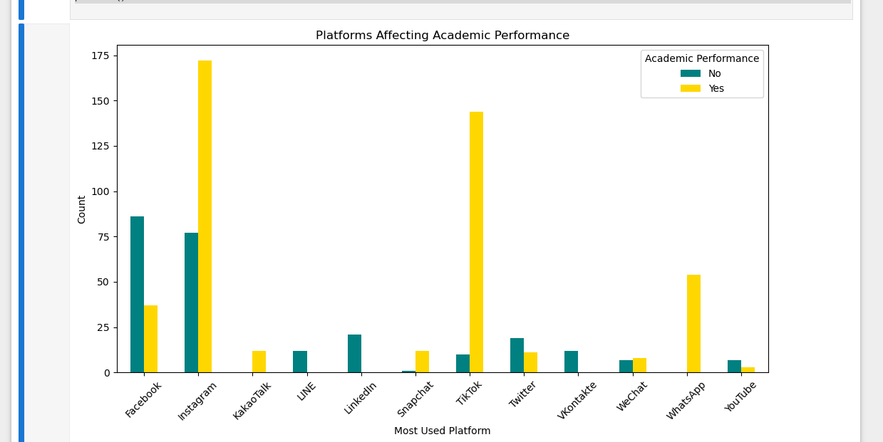
Bar Chart – Platforms vs Academic Performance

Slide 15
Mental Health Score and Sleep Hours by Gender
This stacked bar chart illustrates the average values of two important wellness indicators — Mental Health Score and Sleep Hours Per Night — categorized by gender.
The data is grouped by gender, and the average values of the two metrics are calculated.
A stacked bar chart visually compares these averages between male and female students.
The chart uses two colors:
🔴 Light Coral for Mental Health Score
🔵 Light Blue for Sleep Hours
📌 Insight : Sleep hours and mental health scores are similar across genders, though small differences may exist, useful for deeper analysis into gender-based wellness trends.

Slide 16
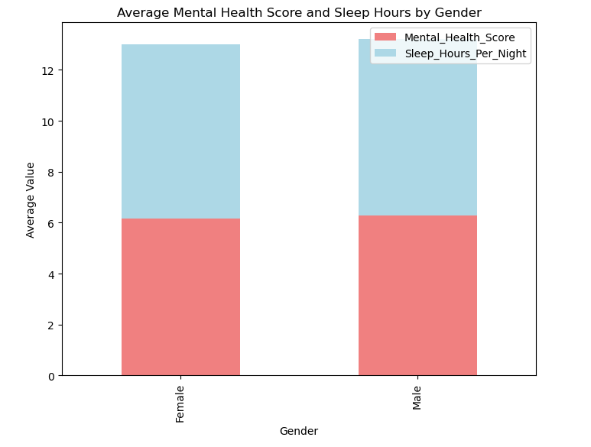
Stacked Bar Chart – Mental Health & Sleep by Gender

Slide 17
Countries by Academic Level
This pie chart shows the percentage of unique countries represented at each academic level in the dataset.
The data is grouped by Academic_Level, and the number of unique countries in each group is counted.
A pie chart is used to visualize the distribution.
Each slice represents the proportion of countries that have students in:
📘 High School
🎓 Undergraduate
🎓 Graduate levels
📌 Insight : The chart highlights which academic levels have wider international representation, indicating where global student participation is more prominent.

Slide 18
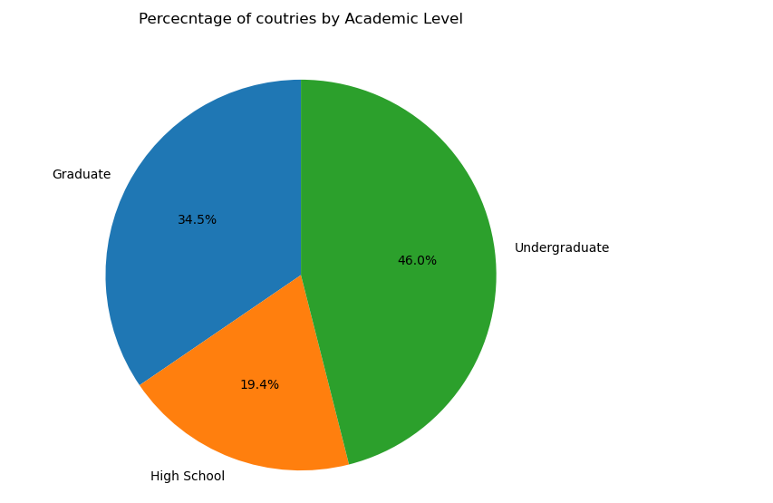
Pie Chart – Countries by Academic Level

Slide 19
Conclusion
High Daily Usage :
Students spend an average of nearly 5 hours per day on social media, indicating a high engagement rate.
Impact on Academics :
Popular platforms like TikTok, Instagram, and WhatsApp are more often linked to negative effects on academic performance.
Sleep and Mental Health :
Average sleep duration (~6.9 hours) is below the recommended level, and mental health scores show room for improvement across genders.
Global Representation :
The dataset includes students from over 100 countries, giving a broad view of how social media habits vary worldwide.
Need for Awareness :
The insights suggest a need for digital well-being education and strategies to promote healthier screen habits among students.

Slide 20
THANK YOU
Linkedin : Click Here

